Slide 1

Linear Relatioships
Yr 12 Essentials

Slide 2
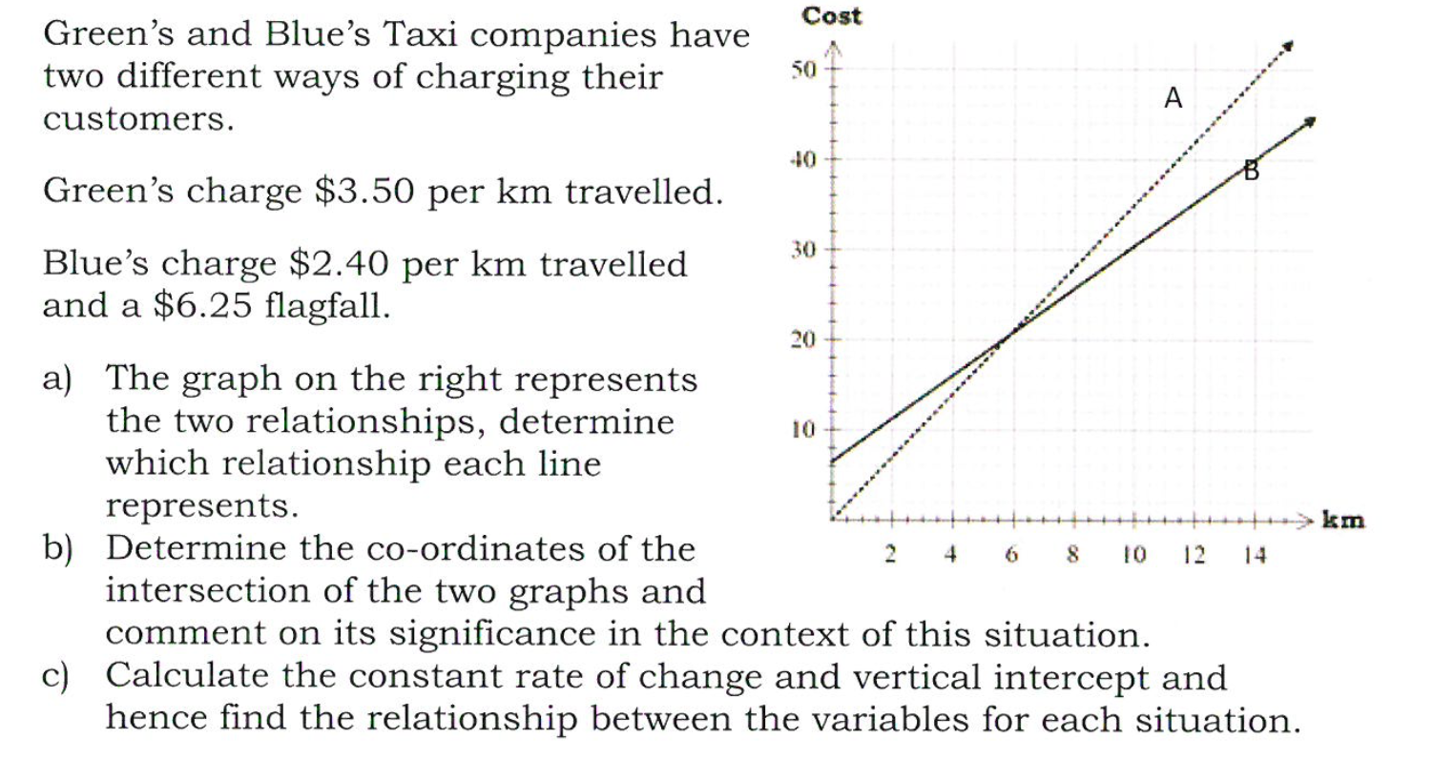
Linear Relationships
Opening Problem

Slide 3
Now Lets consider….

Slide 4
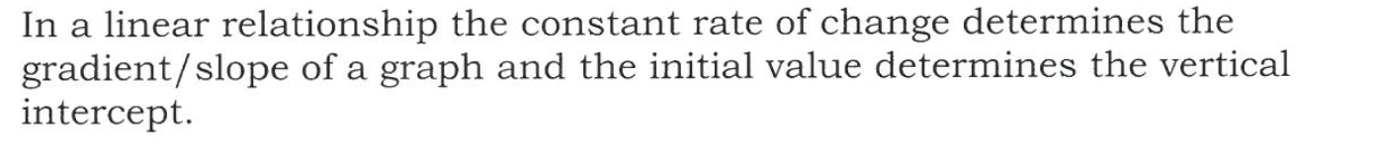

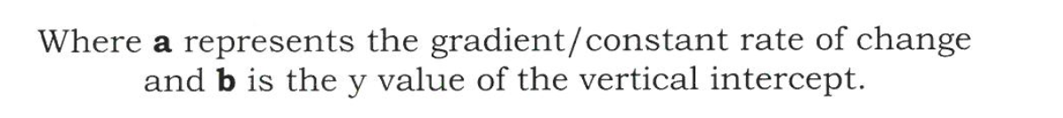
Thinking back to last Term….
EQ: How do you find the relationship between variables using the vertical intercept ( y- intercept) and the constant rate of change (gradient)

Slide 5
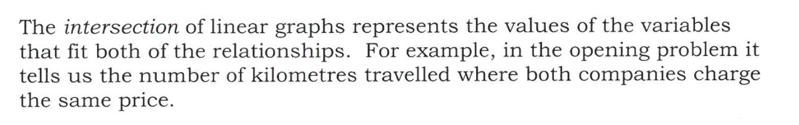
So What does the intersection of the two lines mean?

Slide 6
You Do
Start-Mobile phone Investigation- Continue next lesson
Homework
Chapter 24 Exercises Qu 1-3 pg 87-88

